Slide 1
How to help Your Teen transition to RHSIB Beyond getting involved
This PowerPoint and many referenced links can be found on
MORTERBOARD.COM
PRESENTER: LESLEY MORTER
SCHOOL COUNSELOR
LESLEY.MORTER@HCPS.NET

Slide 2
ACADEMIC SUCCESS ROADMAP
1
2
3
4
MINDSET
TOOLS
TIME MANAGEMENT
STRESS MANAGEMENT

Slide 3
MINDSET - Setting the expectation
What are we doing at school to help get your child off to a great start?
We share and reinforce the following:
G
R
O
W
Everything Counts
Growth Mindset
Start Strong
No Stinkin’ Thinkin’
Negative self-talk
Blaming
Assuming
Minimizing
Participation
Quizzes
Tests
Group Work
Liberal Arts Education – it all matters
Learning for long term retrieval is more important than task completion. You are always learning and growing
Momentum is valuable. It is easier to maintain a good GPA than it is to repair a poor GPA.

Slide 4
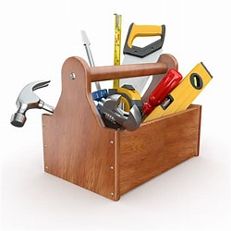
TOOLS
Graphic Organizer
Notes
Pomodoro Method
Questioning Strategies
Canvas
ATTENDANCE
Support System
Routine
Planner / Calendar
icalendar
Outlook
Google
Two Column Notes / Cornell Notes!!!!!!!!
Active recall
Note cards
Timelines
Note Apps have Cornell Note template (Evernote)
Be on time
Be an active participant
Do NOT to skip club day.
Do not leave early if you have a JA at the end of the day
Not to arrive late if you have a JA first block
A day – Do A day homework
B Day – Do B day homework
Avoid the IB black hole ☹ (Thursday to Monday)
Check communication sources regularly (Canvas, RIBLI, PTA, Sign up for Newsletters)
25:5
50: 10
3 sessions
COSTAS (3 levels)
Blooms Taxonomy
Ask questions in class – leadership.
If your child is shy have them start with questions they already know the answer to or ask yes/no, lower level questions.
Student account
Parent Account
Messaging
Parents/Family
Friends
Teachers
IB Coordinator
Student Services
After school tutoring

Slide 5
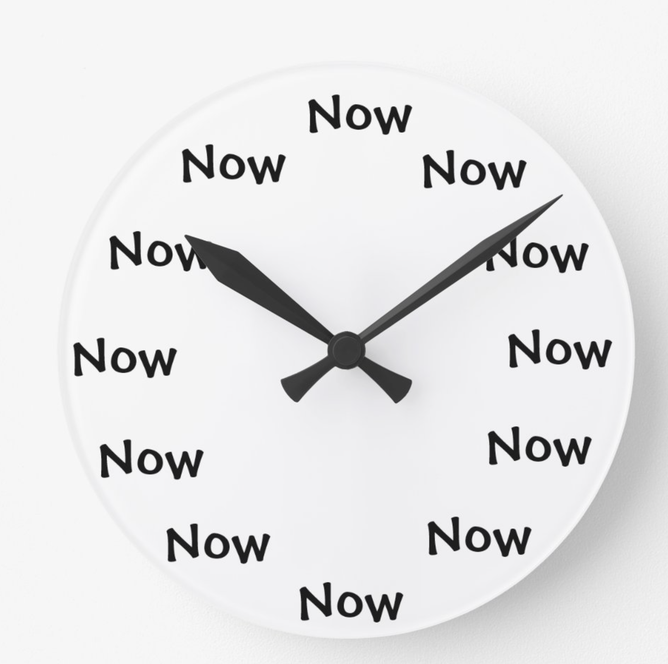
Time Management
Many naturally gifted and talented students have never had to spend a lot of time studying…until now
A Day / B Day
Pomodoro Method
Sleep / Rest
Apps to encourage focus.
A day homework should be done on day A. B day homework should be done on day B.
Use a graphic organizer to “map out” time slots if needed.
25:5 or 50:10
Gives the brain time to forget. When we “re-teach” this moves the information from short-term memory to long-term memory
We all need sown time. Build it in to your teen’s daily routine. Discourage over involvement if you see it happening.
Forest App
2Do
Clockwork Tomato

Slide 6
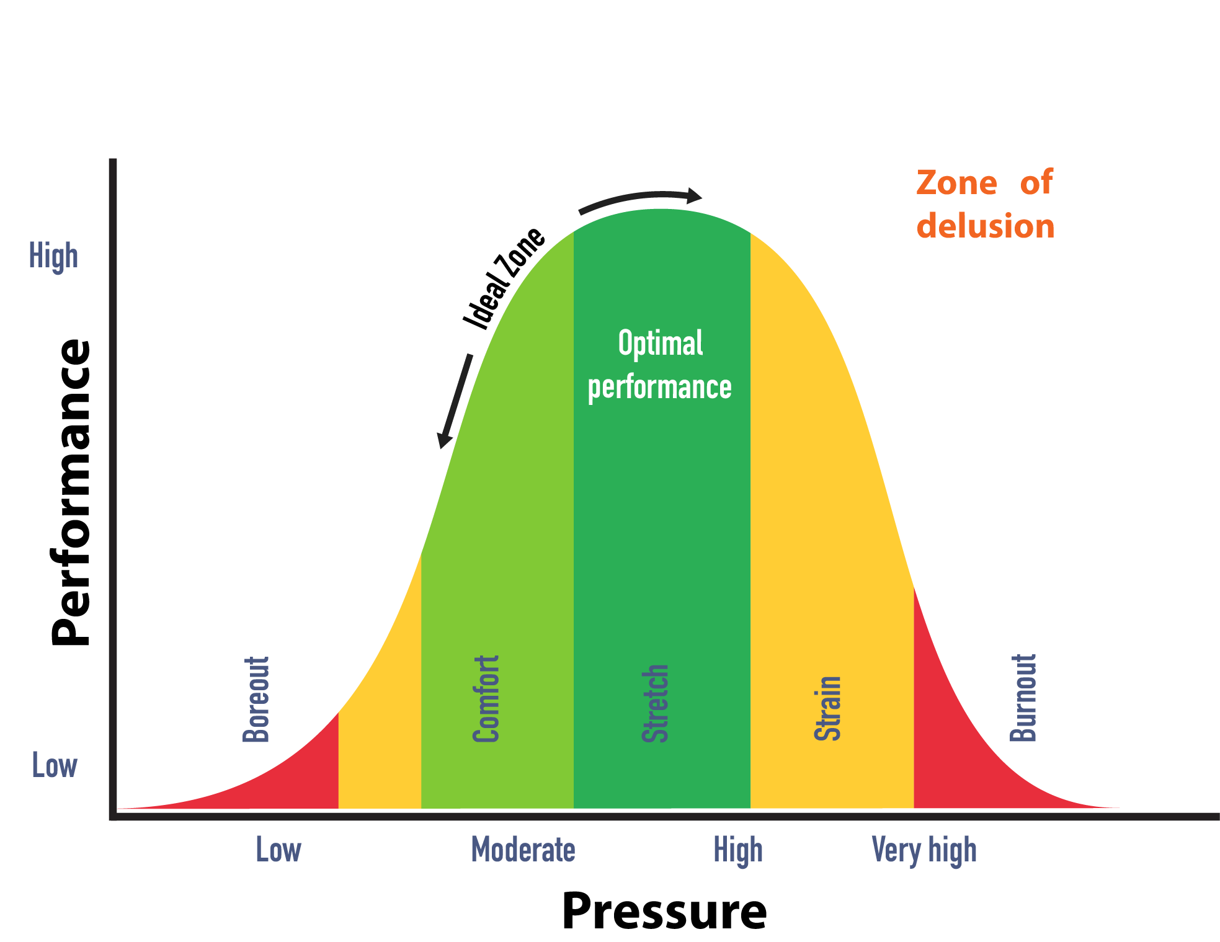
Stress Management
About Stress
Ways to combat stress
Unavoidable
Eustress (+)
Distress (-)
Clinical
Sleep/relaxation
Exercise
Nutrition
Hobbies/clubs
It’s how we handle it that makes a big difference.
Parents: Try not to hit the panic button with your teen.
First day of school
School dances / first dates
College acceptance
Graduation
Being Bullied
Fighting with a friend or family member
Not meeting a deadline
Unmanaged stress can lead to health issues.
Clinical Anxiety goes beyond normal stress.
Diagnosed condition by a licensed professional
Can look different in teens
8 hours min.
No blue light 1 hr. before bedtime
No reading in bed
Mindfulness
Deep breathing
Use apps such as Calm, MindfulGnat, Mindshift
Break a sweat
Make it a regular part of your routine
Yoga
Participate in family sports or other exercise routines
Healthy, balanced meals
Water – refillable station in the lunchroom
Pack snacks if your child is staying after schol
Join clubs
Get involved
Community service should be enjoyable – link it to something your child enjoys
Create or find a relaxation or personal care Bingo Card

